Slide 1


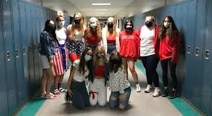
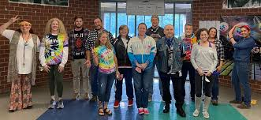
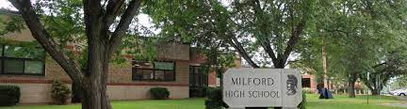
MILFORD SCHOOL DISTRICT
atc/mhs project updates
September 2024

Slide 2
STEERING COMMITTEE UPDATES
PREVIOUS YEARS SCOPE REVIEW
CURRENT YEARS SCOPE REVIEW
NEXT STEPS
AGENDA

Slide 3
STEERING COMMITTEE UPDATES

Slide 4
PREVIOUS YEARS SCOPE REVIEW

Slide 5
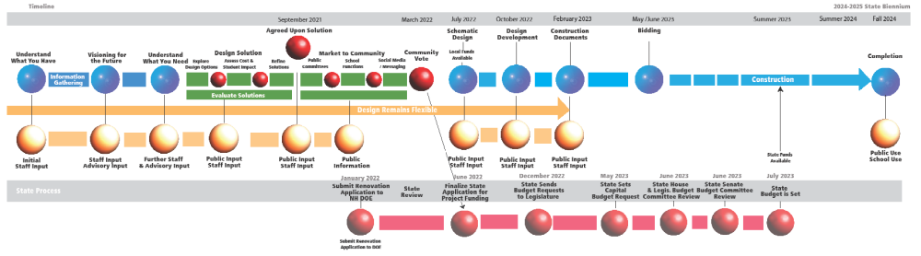
OUR PROCESS INTEGRATED WITH THE STATE
March 2024 or March 2025 Vote
July 1, 2023
Letter of Intent to DOE
January 2024
Full Application to DOE
June 2024
Coordinate With DOE
State Budget Process
July 2025
State Funds Released

Slide 6
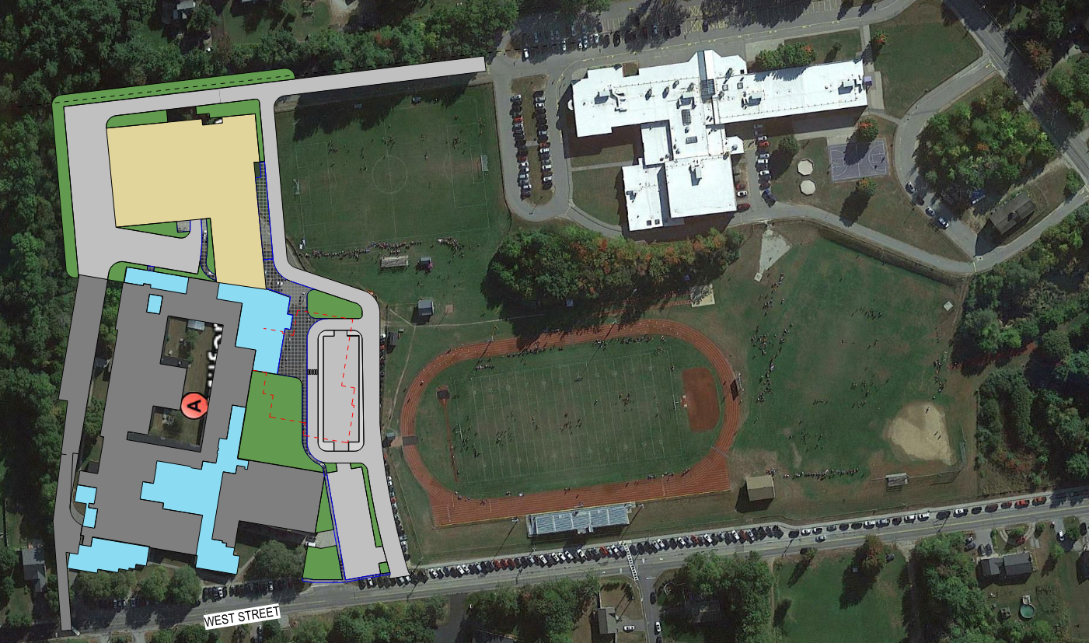
Previous Years Scope
March 2024 Site Plan

Slide 7
Previous Years Scope
March 2024 Exterior Massing

Slide 8
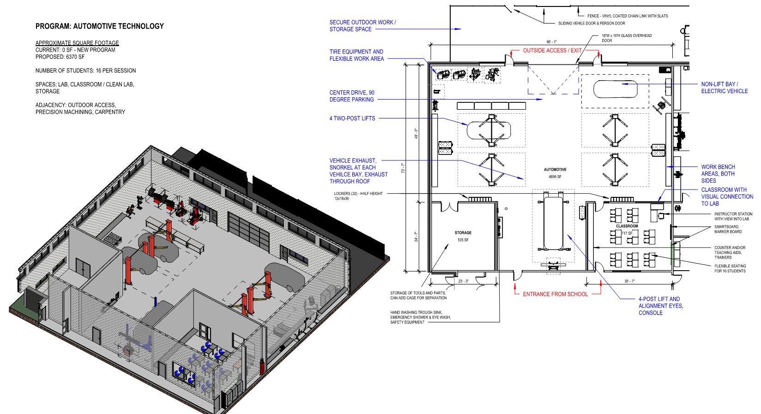
Educational Space Analysis
Automotive

Slide 9
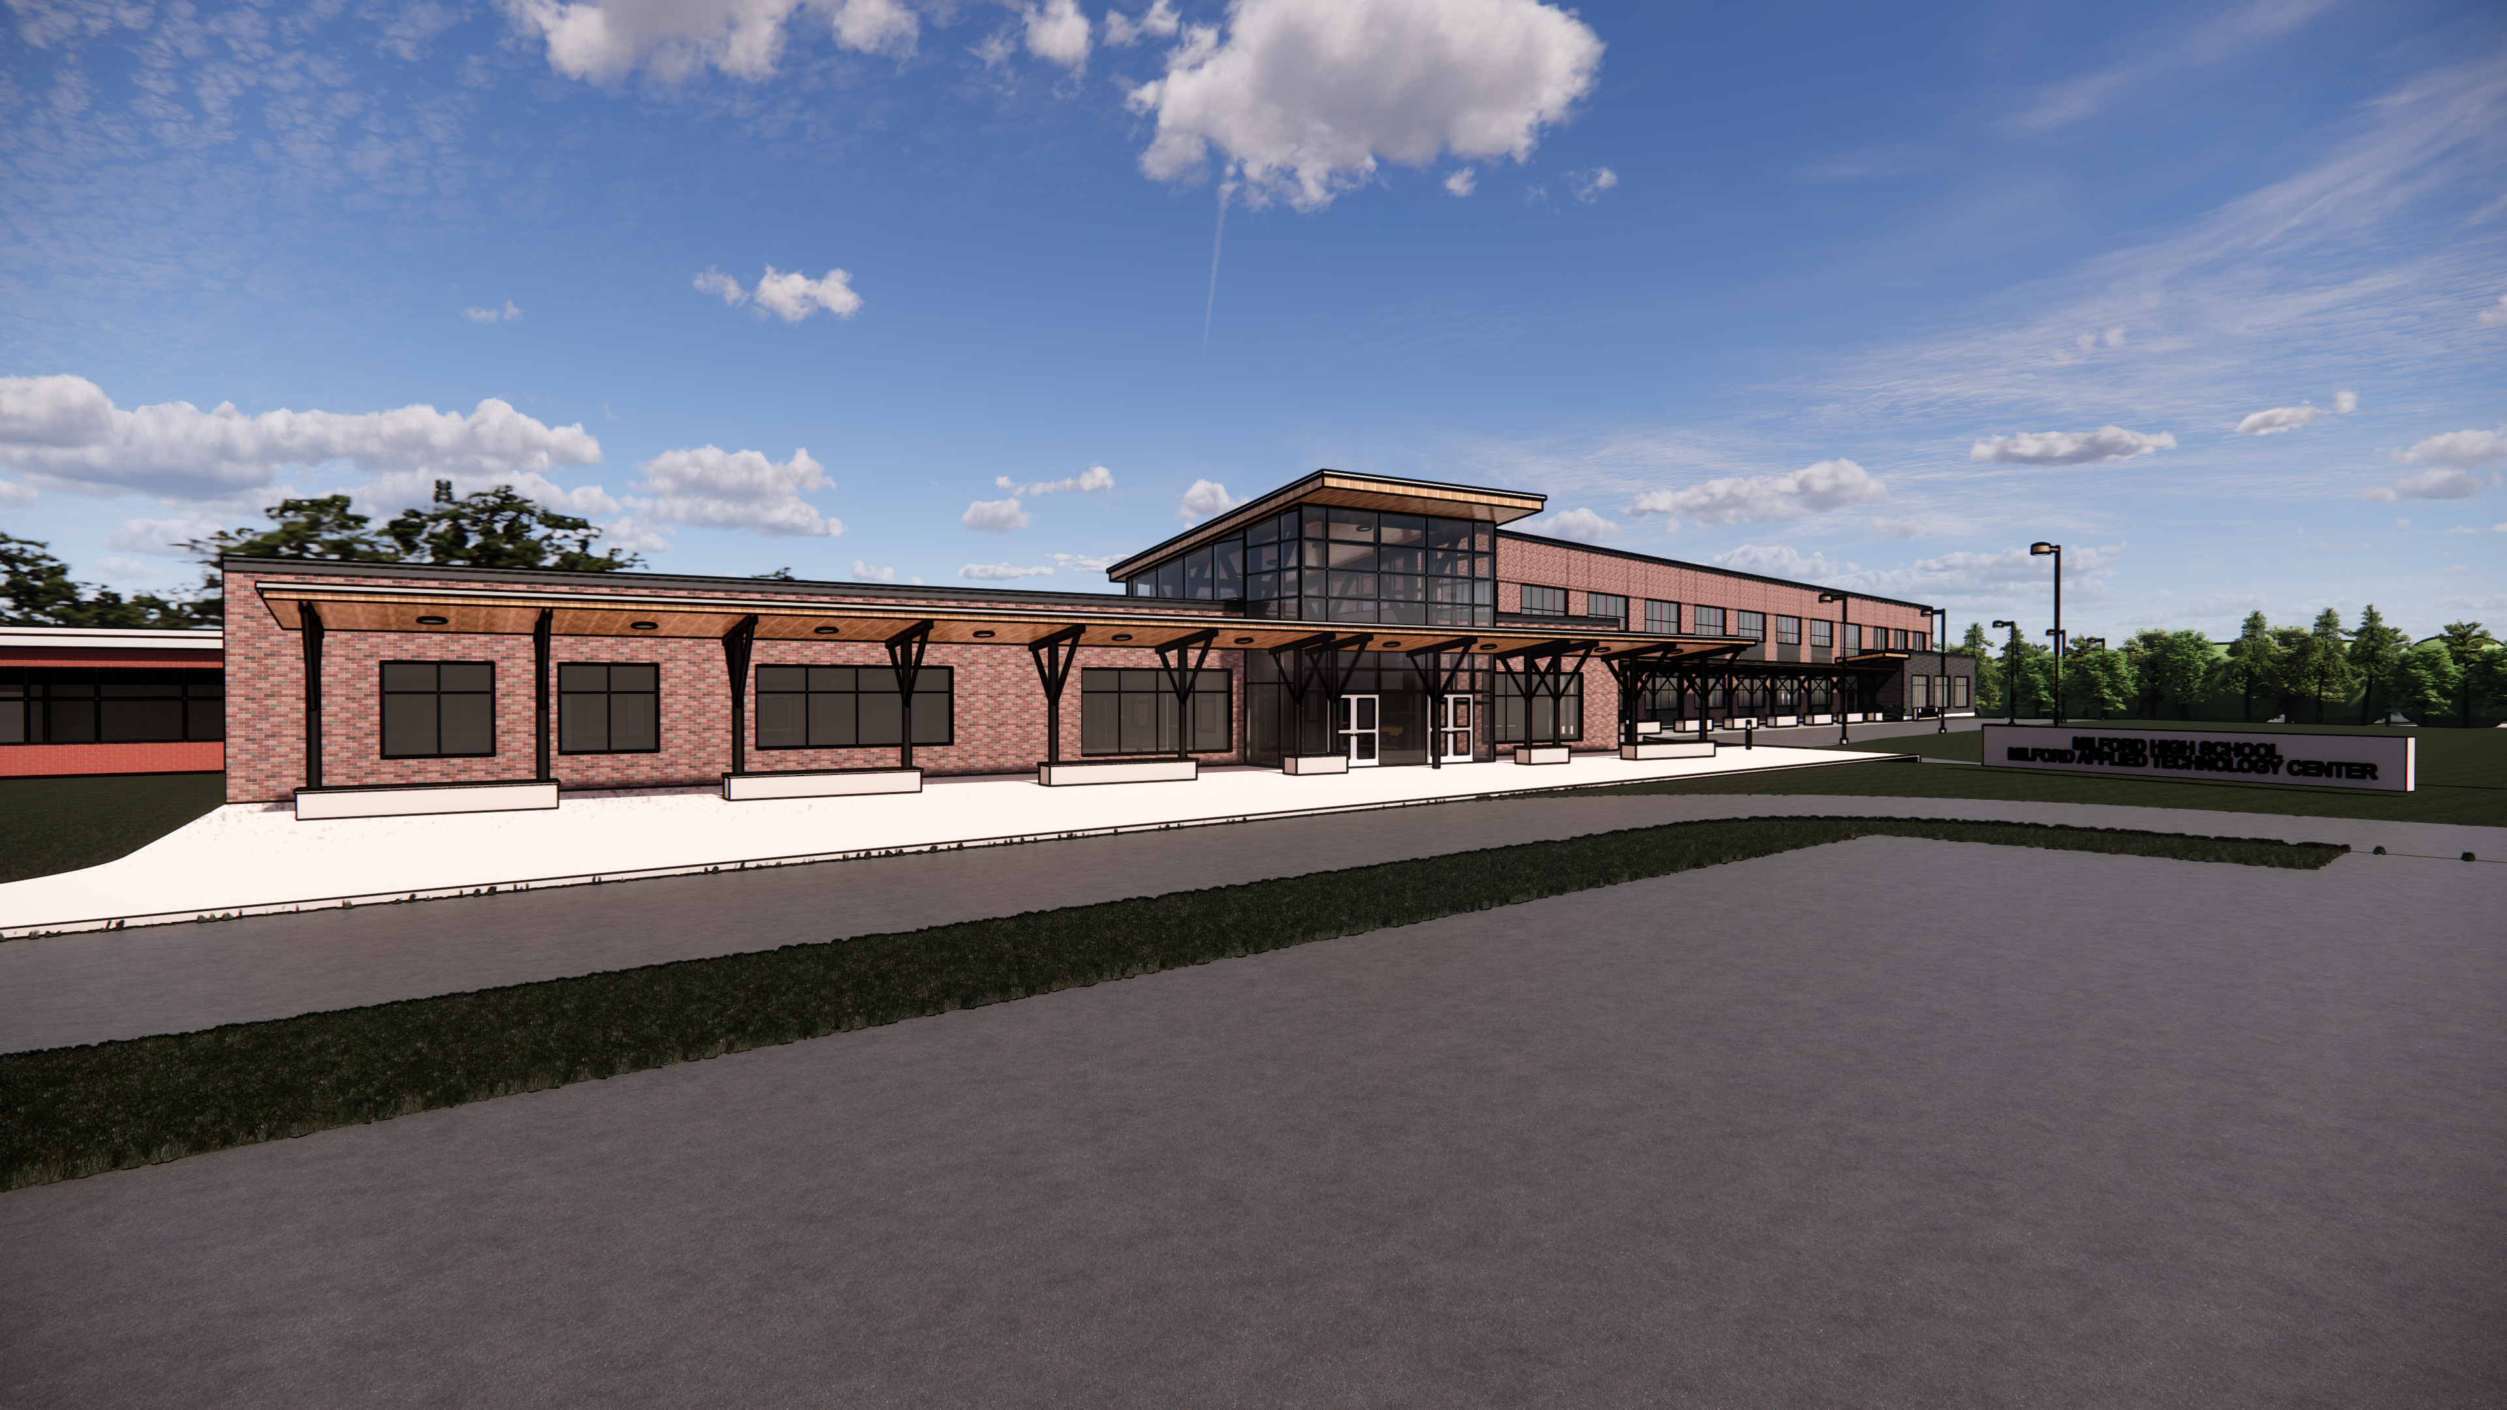
Previous Years Scope
Main Entrance

Slide 10
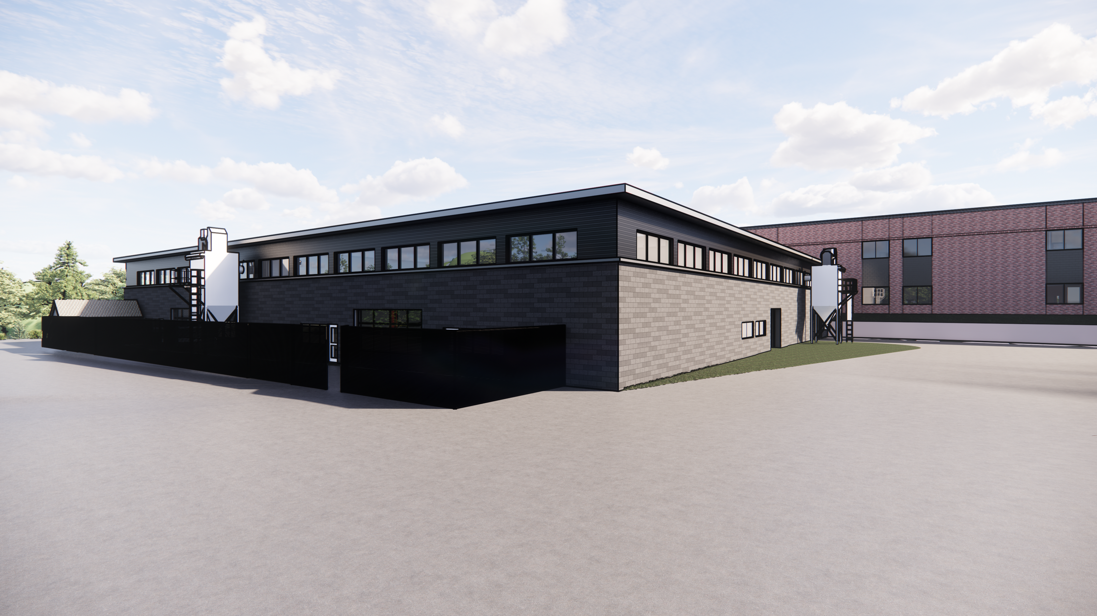
Previous Years Scope
New ATC Building

Slide 11
Previous Years Scope
TOTAL………..…..……………..$58.8 M
LESS STATE CTE FUNDING...$28.3 M
MILFORD BOND:…..…..…..….$30.5 M
3 Displaced Science Labs
New Secure Entrance
MHS Renovations
New ATC Spaces
Project Drive Reno
Art Rooms Reno
MARCH 2024
PROJECT COSTS
75% State Funding applied to Eligible CTE Costs
Estimated Tax Impact
$1.35 per 1000 in Highest Year, Declining thereafter
$405/year on a $300,000 Home

Slide 12
CURRENT SCOPE REVIEW
AS RECOMMENDED BY THE STEERING COMMITTEE

Slide 13
CHANGES TO PROJECT COSTS & SCOPE
1 YEAR ESCALATION: INCREASE (+$4.3M)
UPDATED SITE & BUILDING COSTS: INCREASE
REDUCED SQUARE FOOTAGE: DECREASE
ELIMINATED NEW ENTRANCE: DECREASE
INCREASED DEFERRED MAINTENANCE SCOPE: +$4.3M

Slide 14
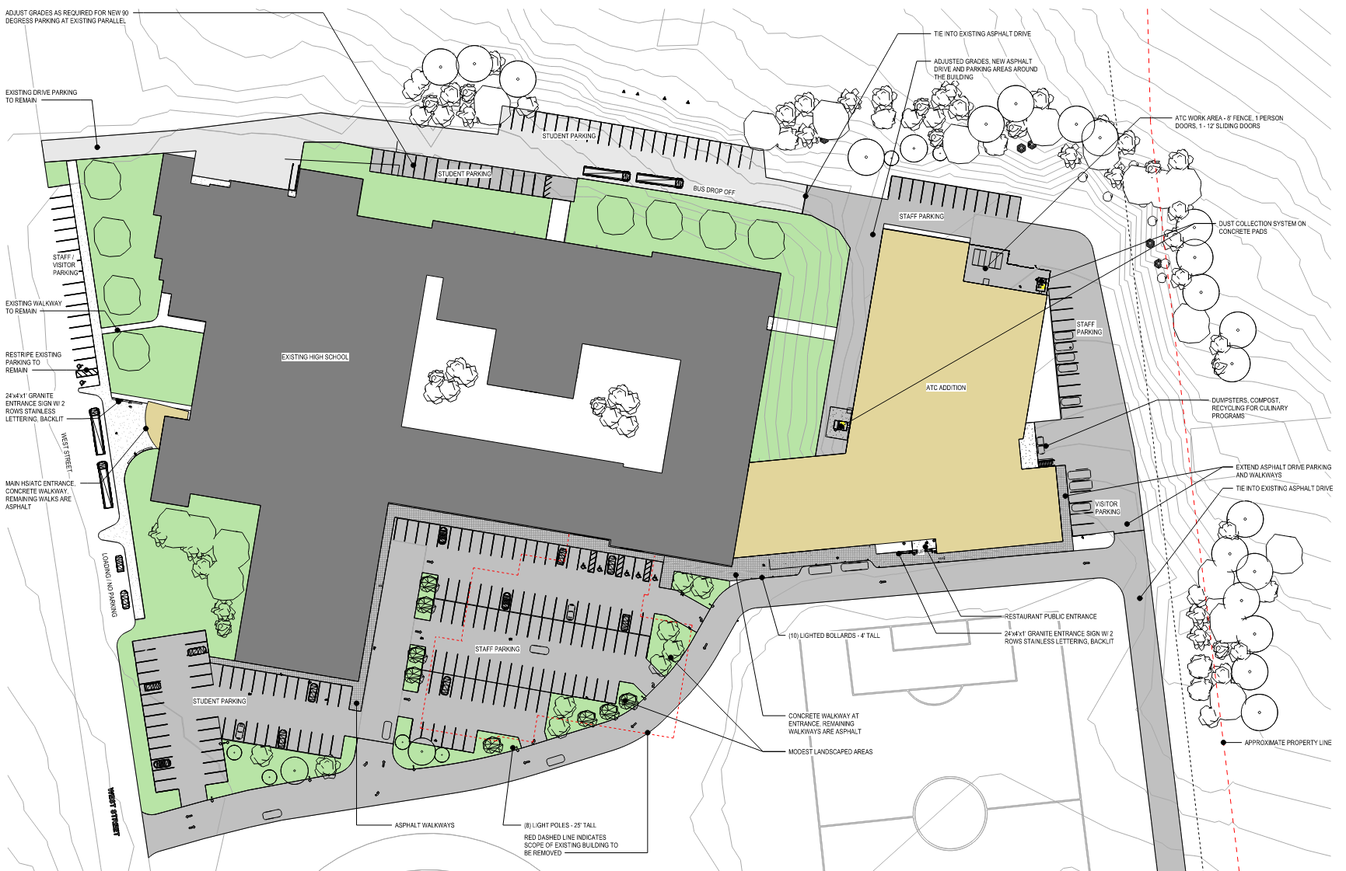
Site Plan

Slide 15
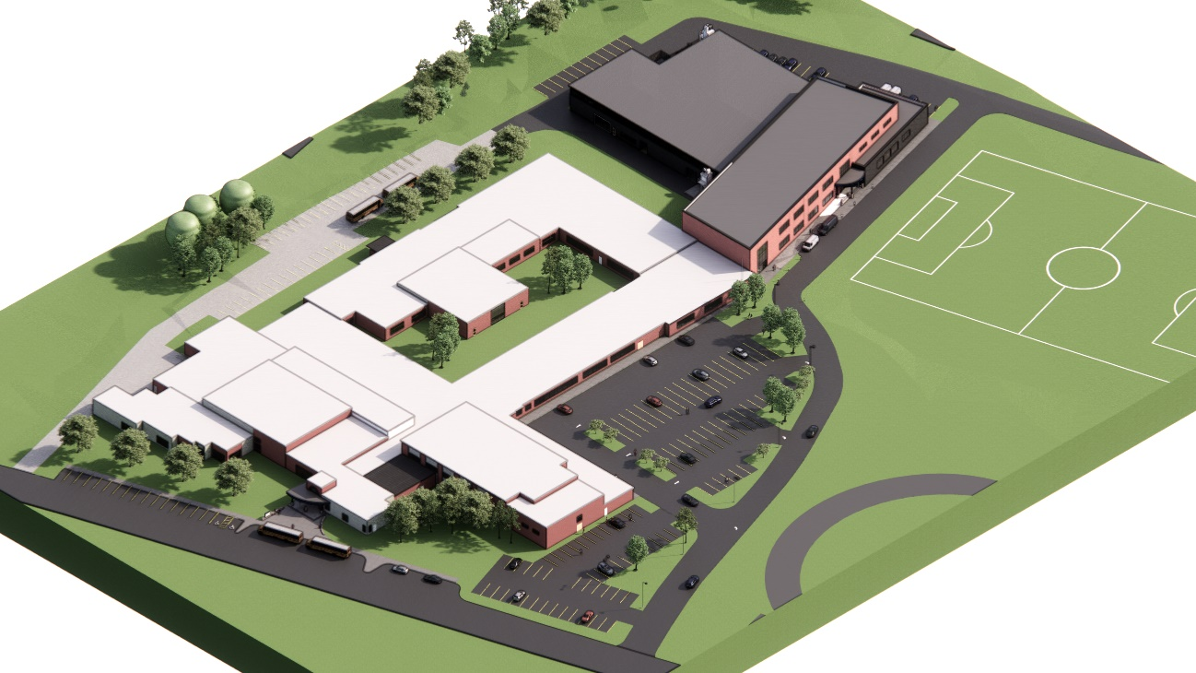
3D Aerial

Slide 16
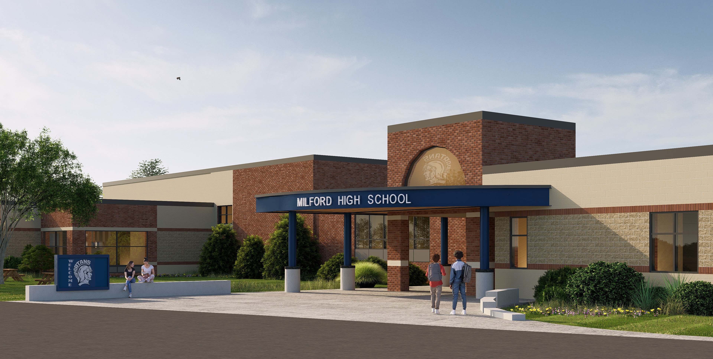
Main Entrance

Slide 17
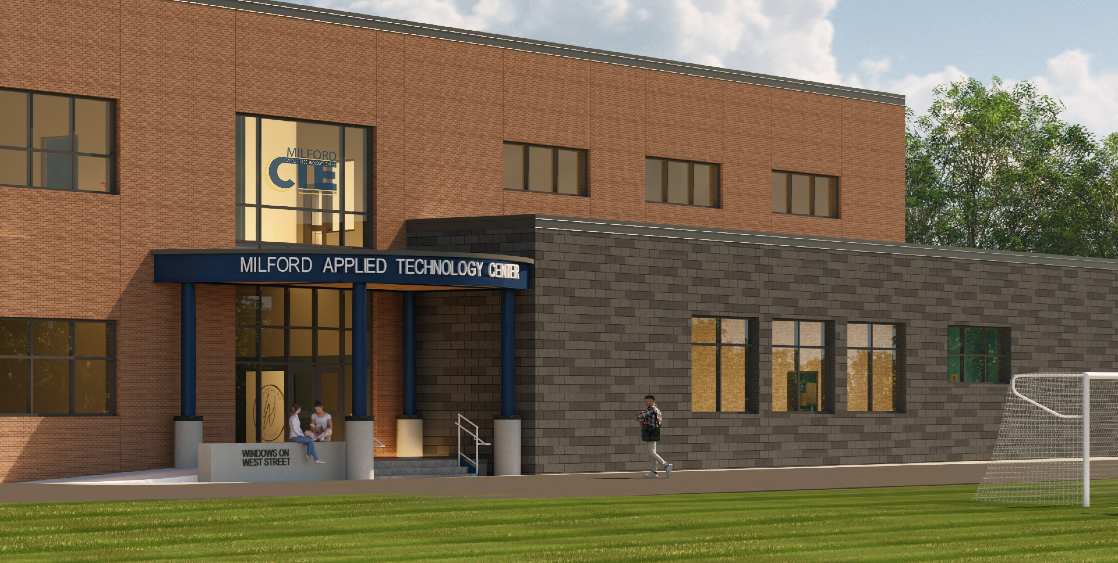
ATC / Restaurant Entrance

Slide 18
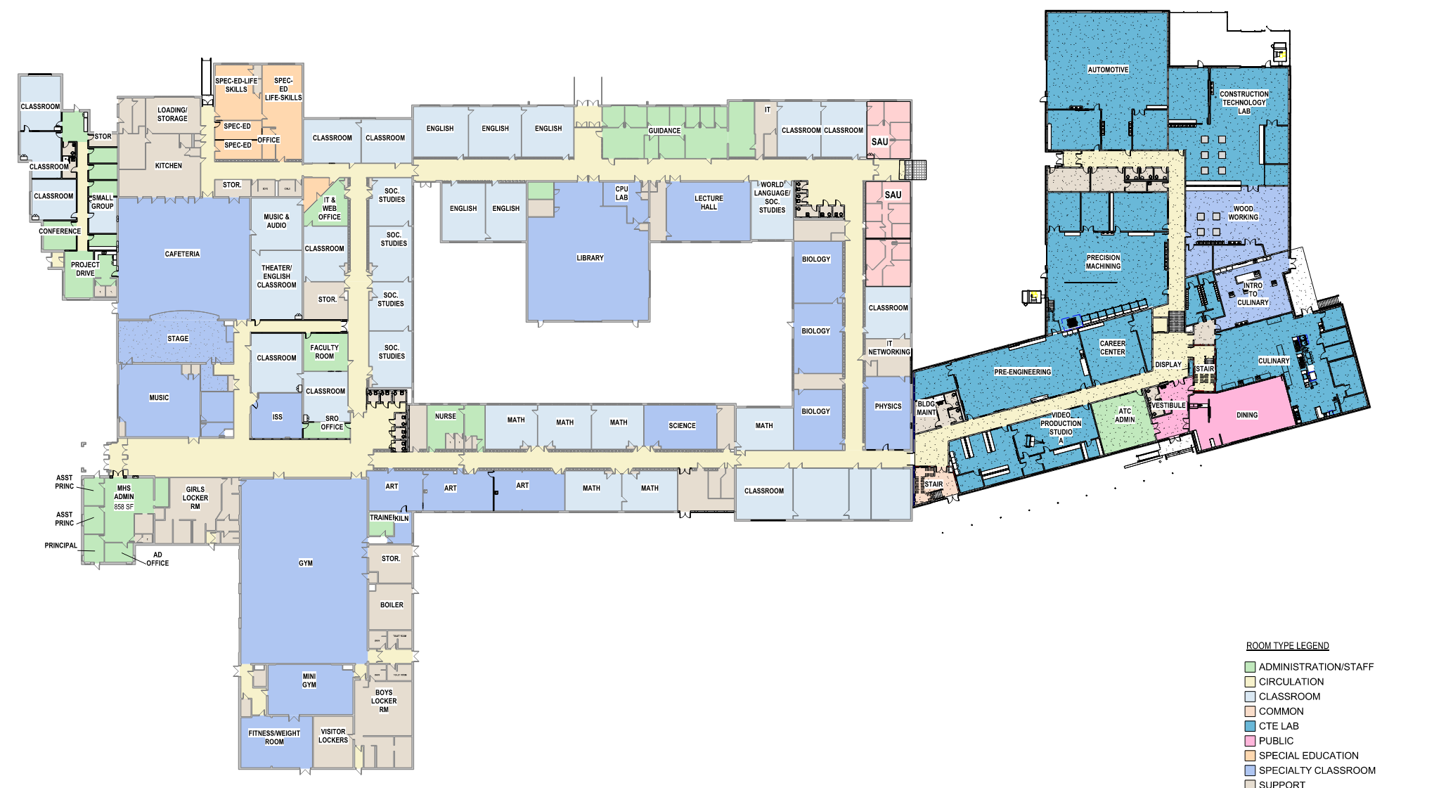
Floor Plan

Slide 19
RENOVATE FOR PROJECT DRIVE
RENOVATE FOR SPECIAL EDUCATION
RENOVATE RESTROOMS
RENOVATE TO ALLOW NEW CTE
RENOVATE FOR ART
RENOVATE FOR CLASSROOM, STAFF, & ADMIN USE
Renovations
RENOVATE FINISHES, LIGHTING, ETC.
ADD AND RENOVATE FOR SECURE ENTRANCE

Slide 20
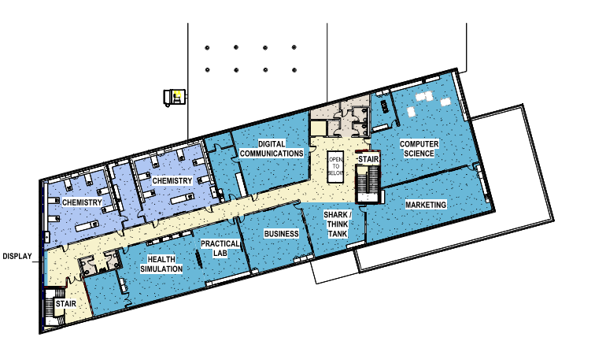
Upper Floor Plan

Slide 21
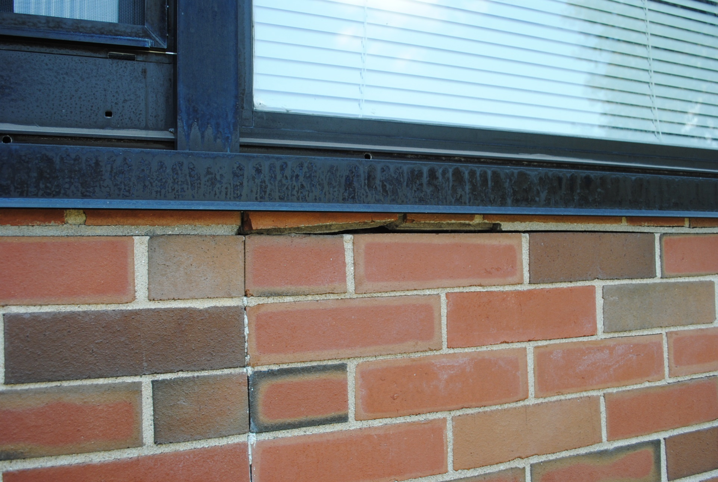
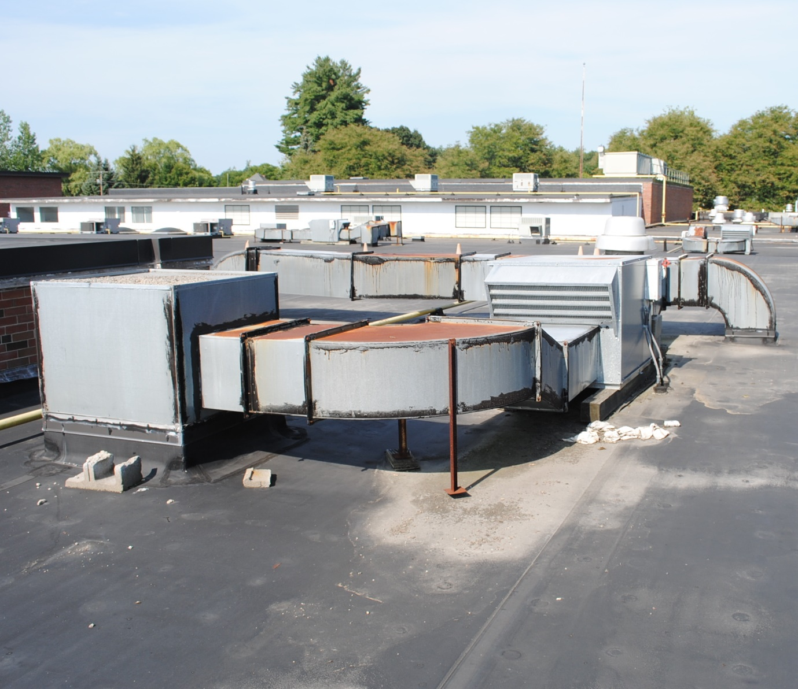
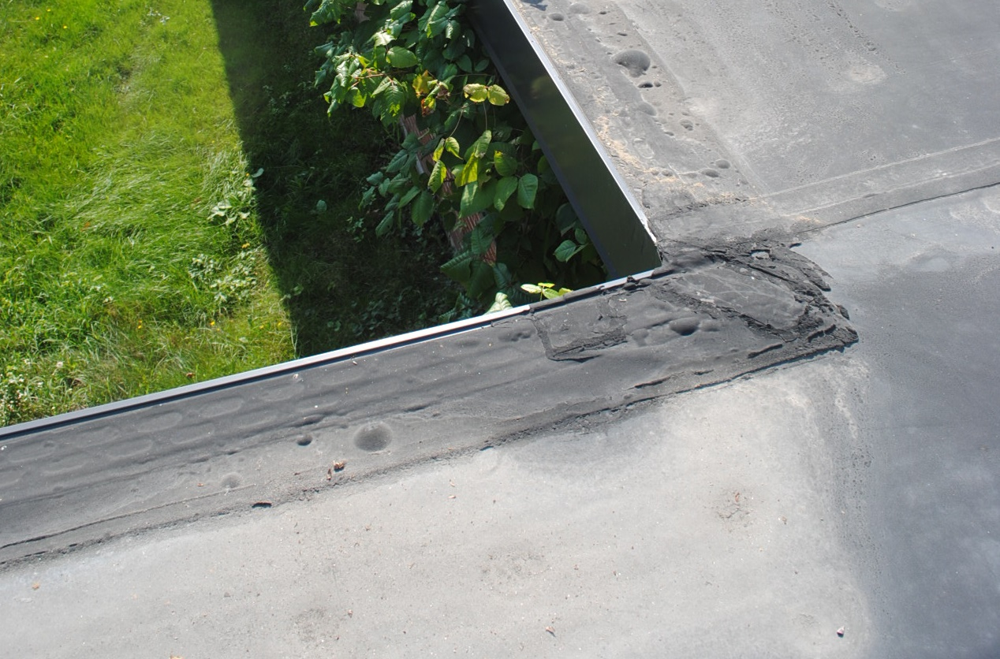
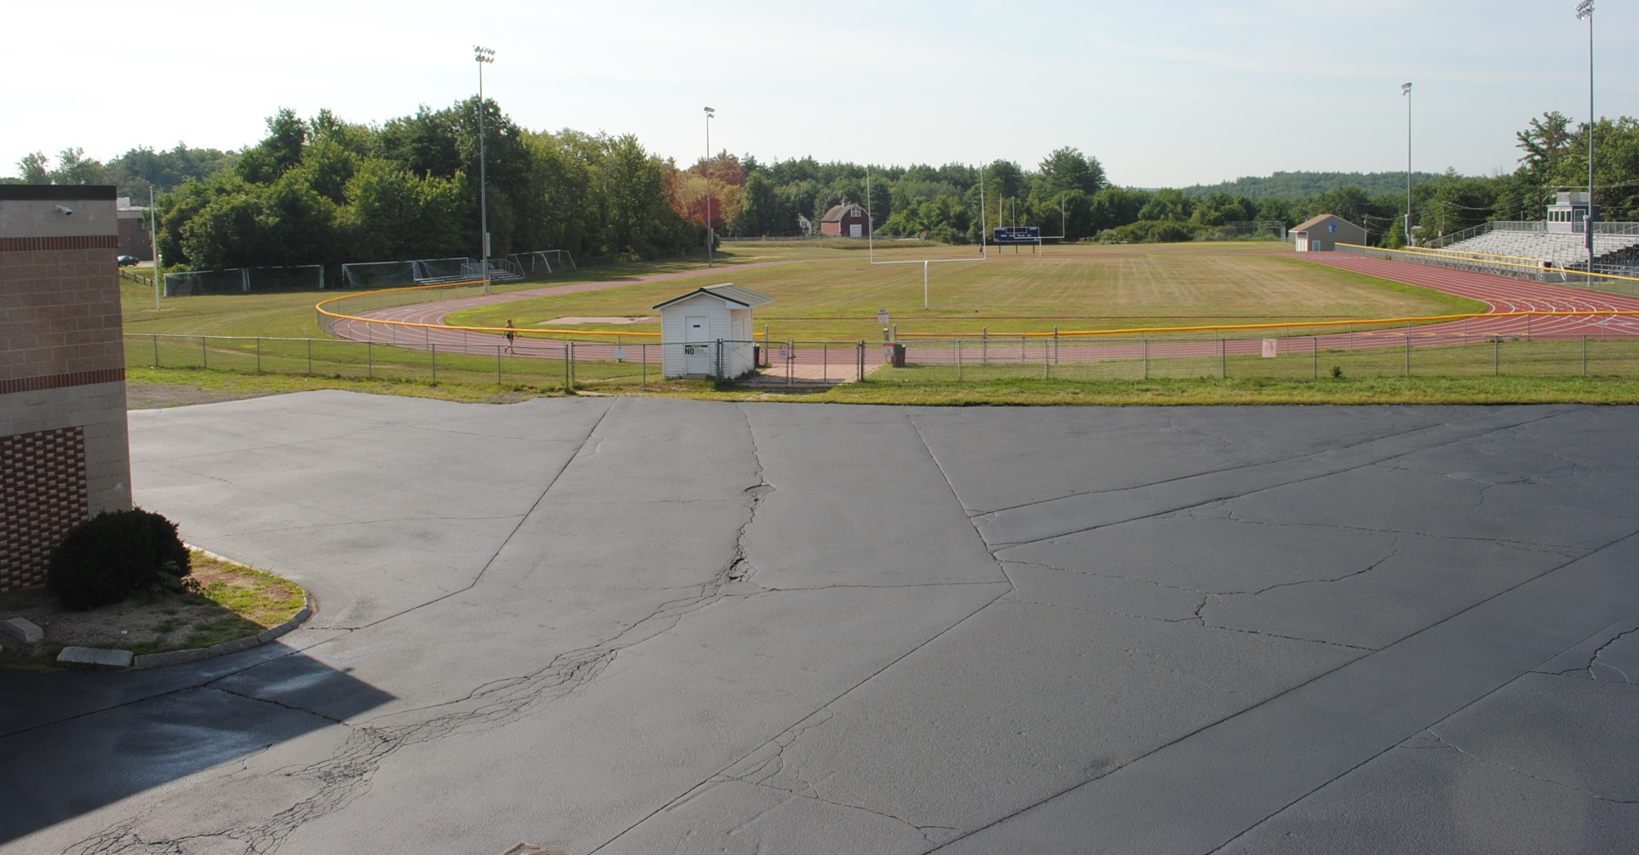
MHS DEFERRED MAINTENANCE & RENOVATIONS
HVAC Upgrades
Envelope Repairs
Site Improvements
Code Issues
Restrooms
Security

Slide 22
TOTAL………..…..……………..$59.82 M
LESS STATE CTE FUNDING...$27.60 M
MILFORD BOND:…..…..…..….$32.22 M
2 Chemistry Labs
MHS Renovations
Woodworking, Foods Labs
New ATC Spaces
Project Drive Reno
Art Rooms Reno
MHS Roof
MHS HVAC
MHS Envelope
MARCH 2025
PROJECT COSTS
75% State Funding applied to Eligible CTE Costs

Slide 23
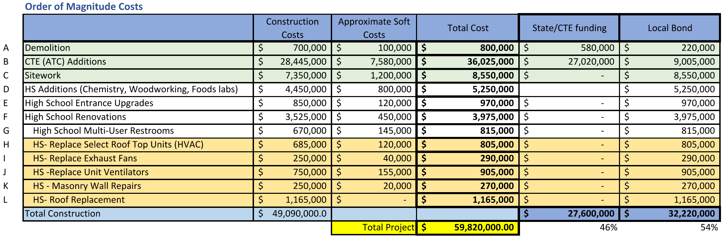
MARCH 2025 PROJECT COSTS

Slide 24




MARCH 2025 PROJECT COSTS
MHS RENOVATIONS
(ENTRANCE, RESTROOMS, CODE ISSUES, SPECIAL ED, PROJECT DRIVE, ART)
NEW APPLIED TECHNOLOGY CENTER
(ADDITIONS, DEMOLITION, SITE)
$44.8M
$5.8M
MHS ADDITIONS
(CHEMISTRY, WOODWORKING,
FOODS LABS)
MHS DEFERRED MAINTENANCE
(SELECT HVAC, ROOF, ENVELOPE)
$3.4M
$5.8M

Slide 25
SCHOOL BOARD DECISIONS
CREATE TAX IMPACTS
CREATE MARKETING MATERIALS
COMMUNITY ENGAGEMENT
NEXT STEPS

Slide 26
